Slide 1




Major Economic Crises
This presentation will explore 10 of the most significant economic crises in modern history, from the Great Depression to the European Sovereign Debt Crisis.
by Anoop Mohanty
AM

Slide 2


The Great Depression (1929)
1
Widespread Unemployment
Millions lost their jobs as the economy contracted sharply.
2
Stock Market Crash
The stock market crashed, wiping out wealth and investor confidence.
3
Global Economic Downturn
The crisis spread globally, impacting trade and economies worldwide.

Slide 3

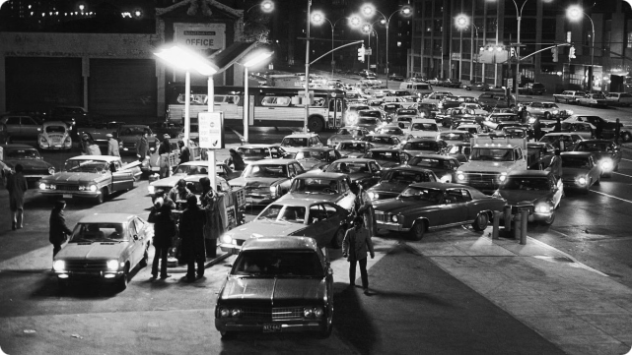
OPEC Oil Crisis (1973)
1
Oil Embargo
OPEC imposed an oil embargo, restricting supply and driving up prices.
2
Global Recession
The resulting energy crisis triggered a global economic recession.
3
Lasting Impacts
The crisis led to long-term changes in energy policy and consumption habits.

Slide 4
Latin American Debt Crisis (1980s)
Rising Debt Levels
Falling Commodity Prices
Defaults and Restructuring
Many Latin American countries had accumulated unsustainable levels of foreign debt.
Dropping prices for exports like oil and minerals made debt repayment difficult.
Several countries defaulted on their debts, leading to a prolonged economic crisis.

Slide 5


Black Monday (1987)
Stock Market Crash
On October 19, 1987, global stock markets crashed, losing over 20% of their value in a single day.
Causes
Factors like program trading, portfolio insurance, and investor panic contributed to the rapid selloff.
Lasting Impact
The crash erased billions in wealth, though the economy avoided a prolonged recession.
Lessons Learned
It highlighted the need for better market regulations and risk management.

Slide 6

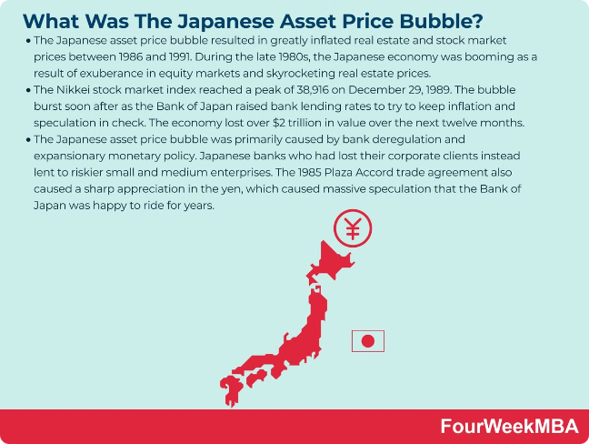
Japanese Asset Price Bubble (1991)
1
Rapid Asset Inflation
Japanese real estate and stock prices skyrocketed to unsustainable levels.
2
Economic Stagnation
The bubble's bursting led to a prolonged period of economic stagnation and decline.
3
Lessons for Policymakers
It demonstrated the risks of asset price bubbles and the need for prudent monetary policy.

Slide 7
Asian Financial Crisis (1997)
Currency Devaluations
Overheated Economies
Regional Contagion
Several Southeast Asian currencies collapsed, triggering a wider financial crisis.
Excessive borrowing, real estate speculation, and lack of regulation contributed to the crisis.
The crisis spread rapidly across the region, impacting economies from Thailand to South Korea.

Slide 8

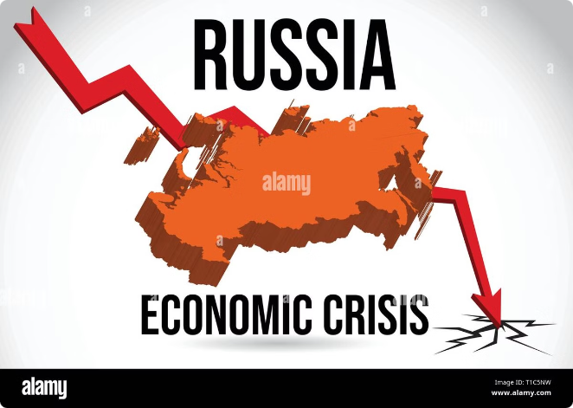
Russian Financial Crisis (1998)
Debt Default
Russia defaulted on its government bonds, sparking a collapse in the ruble and financial markets.
Economic Collapse
The crisis led to a severe economic recession, hyperinflation, and widespread business failures.
Geopolitical Implications
The crisis weakened Russia's global influence and led to political instability.
Lessons Learned
It highlighted the importance of sound fiscal and monetary policies to maintain financial stability.

Slide 9
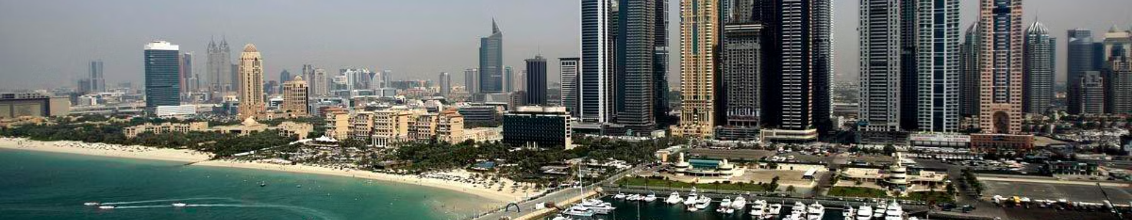



Dubai Real Estate Crisis (2009)
Rapid Growth
Bursting Bubble
Economic Fallout
Dubai's real estate market experienced a massive bubble driven by excessive speculation.
The global financial crisis triggered a collapse in Dubai's property prices and construction activity.
The crisis led to a decline in foreign investment, job losses, and a broader economic slowdown.

Slide 10



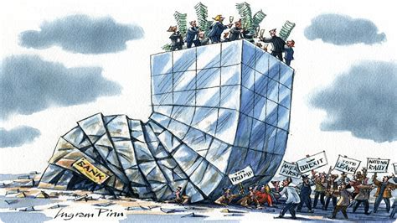


Global Financial Crisis (2007-2008)
Subprime Mortgages
Risky lending practices in the U.S. housing market sparked the crisis.
Banking Sector Collapse
The crisis led to the failure and bailout of major financial institutions.
Stock Market Crash
Global stock markets plummeted, wiping out trillions in wealth and investor confidence.
Worldwide Recession
The crisis triggered a severe global economic recession with long-lasting impacts.

Slide 11


European Sovereign Debt Crisis (2010)
Country
Debt Burden
Impacts
Greece
High government debt and deficits
Austerity measures, bailouts, and economic downturn
Ireland
Banking sector collapse and real estate bubble
Recession, banking crisis, and sovereign debt crisis
Spain
Real estate bubble and high unemployment
Recession, banking crisis, and sovereign debt issues
Italy
High government debt and slow economic growth
Debt crises, political instability, and economic stagnation

